Slide 1


Regenerative Agriculture and Justice Initiative
Cross-Sector Collaboration for Public Policy

Slide 2
Regenerative Agriculture Initiatives
Farm Bill Advocacy
Working with our broad alliance to continue to push on our collective targeted and specific policy priorities
Public Private Partnership with Department of Interior
Supporting economic opportunity with Tribal nations and communities with a focus on Buffalo restoration through regenerative and Indigenous Ecological practices
Diversifying for Regenerative Agriculture Supply Chains
Focused on challenges and solutions for matching big brands with supply chain partners who use sustainable methods.
Climate Smart Commodities
The Growing GRASS & Climate-Smart Value-Added U.S. Commodity Markets Project is a 5-year USDA Climate Smart Commodity project to develop the Generalized Regenerative Agriculture Sourcing Specification verification system and markets, with a specific focus on climate smart byproducts.
We are catalyzing broad business, investor and stakeholder support for public policies that support a transition to a regenerative and just agricultural economy

Slide 3
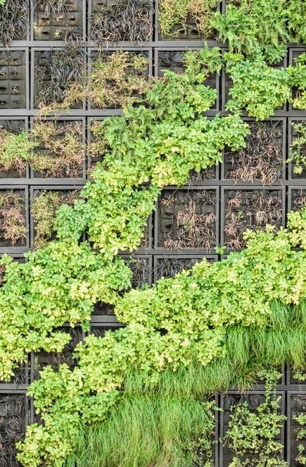
Overview of the Working Group
Food and Fiber Regenerative
Practice
Regenerating soil and broader ecological health
Carbon sequestration through soil health
Promoting place based and culturally appropriate regenerative practices
Farm and Labor Justice
Justice for past and current
discrimination in agriculture
Equitable access to land,
resources, and
markets
Price parity for farmers
Labor justice/rights and a living wage
Resilience
Infrastructure and supply web development for regenerative, organic, and local and regional food systems
Addressing concentration and monopolies
Promoting soil health for climate resilience
Support for alternative economic systems (e.g. cooperatives, CSAs, circular economies, and mutual aid)
We are catalyzing broad business, investor and stakeholder support for public policies that support a transition to a regenerative and just agricultural economy
Before becoming voting members of the working group, businesses and organizations must agree to shared principles collectively established at the group’s launch

Slide 4

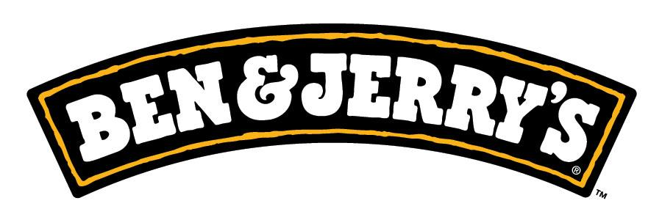

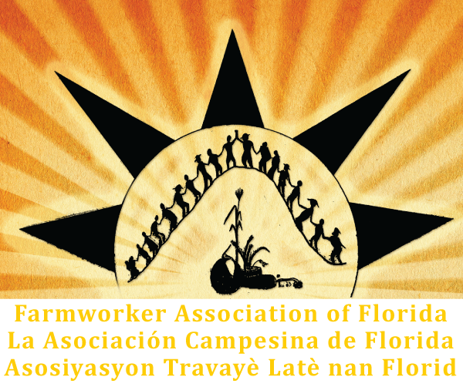



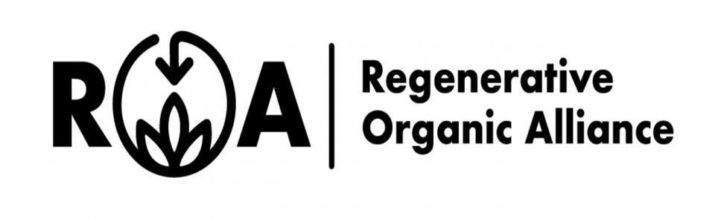
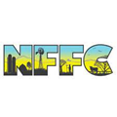
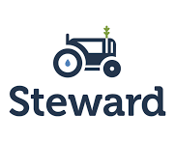




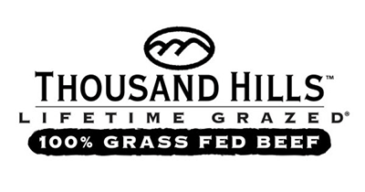













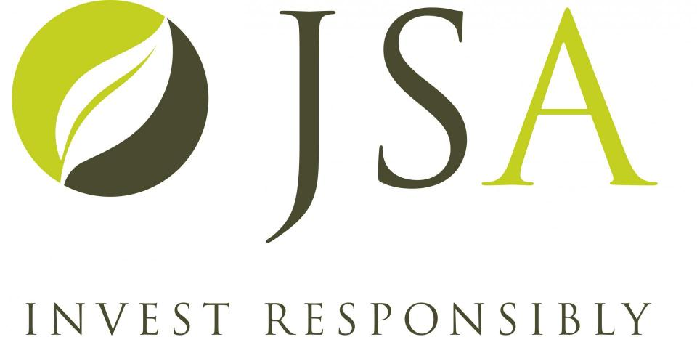


Voting Members

Slide 5
Past Work
Comments to The White House Conference on Nutrition, Food, and Health
The 2023 Agriculture, Rural Development, Food and Drug Administration, and Related Agencies Appropriations Bill Letter
Regenerative Agriculture and Justice Priorities Memo for the Build Back Better Agenda
Comment Letter to the USDA on how to implement climate-smart agriculture
Recommendations for Biden/Harris USDA action in first 100 days Transition letter’
Farm Bill fly-in with over 40 business and farmer leaders

Slide 6
Environmental Justice and Community Based Organization Members and Partners
The Farmworkers Association of Florida
Rural Coalition
Coming Clean Coalition
Federation of Southern Cooperatives/Land Assistance Fund
Latino Farmers and Ranchers International
Intertribal Agriculture Council
Alianza Nacional de Campesinas
National Young Farmers Coalition
Healthcare Without Harm
Cooperative Food Empowerment Directive

Slide 7
Moving forward with the Farm Bill
Our work will include:
Work with a broad alliance to continue to push on our collective targeted and specific policy asks that will advance the priorities outlined in the previous To advance these priorities, We will continue to mobilize the wide range of business, investor, farm and agriculture organizations that we have built into our Regenerative Agriculture & Justice network. We will use this existing base to engage on the range of tactics that will be utilized to encourage greater acceptance of key priorities by legislators.
Build out the “”Business Case for Regenerative Agriculture” in the Farm Bill including stories from business leaders and farmers on (1) how regenerative agriculture is building more resilient supply chains, and (2) how policy could remove barriers for businesses trying to procure U.S. produced regenerative and just food and fiber & meet growing consumer demands.
Continue to build our work closely with underserved and discriminated against farmers, businesses, communities, and stakeholders.
In our model that works to ensure inclusivity we would also subgrant underserved farmers and justice groups to ensure their participation in the working group and associated activities.

Slide 8
Regenerative and Just Agriculture in the 2024 Farm Bill
We are making the following demands on Congress. See more here
SUPPORT
1. Land access and support for beginning farmers and ranchers, especially for small-scale farmers, discriminated against groups, and regenerative producers
2. Debt relief for underserved and discriminated against farmers
3. Farmworker support, including housing and nutritional support program eligibility for undocumented workers
INVEST
4. Investment in market development, processing, and infrastructure for regenerative, organic, and local and regional farmers
5. Development of USDA-approved meat processing capacity to provide access to markets for local and regional farmers and ranchers
INCENTIVIZE
6. Incentives, training, outreach, credit/finance, and payments for regenerative practices, including organic and indigenous/traditional ecological practices
7. Federal crop insurance updates to reward the adoption of de-risking practices (like cover cropping, increased diversity, and reduced tillage), rather than penalizing them
8. Redirect USDA incentives away from destructive concentrated feeding operations and towards regenerative systems using managed grazing and reincorporation of livestock in cropping systems

Slide 9


Climate Smart Commodities
GRASS uses recognized indicators for grazing management, systems implementation and environmental and social outcomes to validate and support regeneratively raised livestock claims, including:
  soil health, carbon sequestration & grass/forage management
  animal health & welfare
  biodiversity and environmental enhancement & protection
  producer benefit & inclusion
The GRASS equivalency approach for verification provides accessibility & options to farmers/ranchers regarding which certification system works best for their operation, including access to multiple value-added markets.
Created for the leather and apparel market, GRASS is focused primarily on increasing supply, utilization & valuation of hides and other meat processing byproducts from regeneratively-raised livestock.
Growing Grass is a 5-year research, demonstration and evaluation project intended to develop, test and evaluate how the Generalized Regenerative Agriculture Supply Specification (GRASS) verification system, markets and supply chains can optimize total value and climate performance/ benefits of regeneratively grazed cattle, with a specific focus on byproducts and economic returns to farmers/ranchers.
This multi-year project through USDA will pilot, test, and evaluate how the GRASS supply chain can be optimized for value and climate performance from farm and ranch to climate-smart markets, starting with the greenhouse gas benefits of grazing systems.
Notes:
Add note to this slide

Slide 10
















Why Growing GRASS?
Certified Climate Smart Goods
Certified Climate Smart byproduct materials
Certified Climate Smart Animals (e.g. GRASS)
Leather
Organs
Tripe
Intestines
Blood meal
Protein meal
collagen
etc
Hide processors & tanners
Climate Smart Byproducts – Material Flow
Slaughter plant
COLLAGEN
Certified Climate Smart Producers (e.g. GRASS)
Rendering
Brands & Product makers
Enlightened consumers
Supply
Processing/production
Demand
feedback
feedback
Why aren’t there “climate-smart” goods (derived from climate smart byproducts) today?
Lack of supply?
Lack of processing?
Lack of demand?
Lack of feedback up the stream?
Growing GRASS will look at each part of the value-chain, identify the barriers, and develop, test and publicize best practices and solutions.

Slide 11
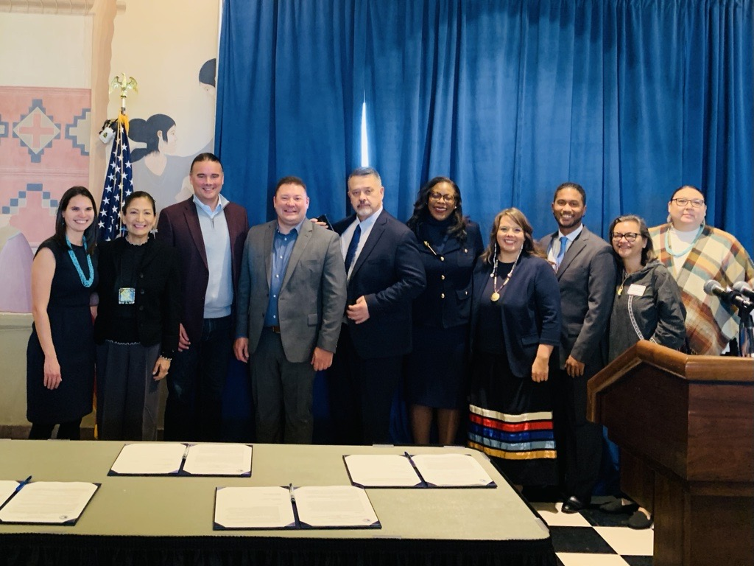
Department of Interior - Indian Affairs Office of Strategic Partnerships
Public Private Partnership with Department of Interior
About:
Announced by Secretary Haaland at the 2022 Tribal Nations Summit.
Signed 4 Partner MOUs focused on building public-private partnerships to leverage federal, philanthropic and private sector funding to support Tribes and Native-led organizations. American Sustainable Business Network, Native Americans in Philanthropy, Native CDFI Network, Oweesta & Enterprise Community Partners
Focus Areas:
Economic Development, including access to capital
Native-led Conservation
Education, with a focus on Native language revitalization

Slide 12
Targeted Initiative
Supporting economic opportunity with Tribal nations and communities with a focus on Buffalo restoration through regenerative and Indigenous Ecological practices
Public Private Partnership with Department of Interior
  Goals:
  Increase the capacity of Tribal communities to engage and collaborate with the business community and other entities to leverage federal and Tribal resources to support tribally-led community based economic development.
  Develop best practices and tools for fostering business development and entrepreneurship within Tribal communities.
  Provide resources to Tribes interested in developing Tribal-public-private partnerships.
  Provide guidance to philanthropic and private sector organizations interested in engaging directly with Tribal Nations.

Slide 13


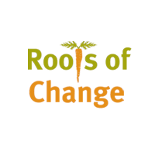

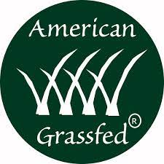



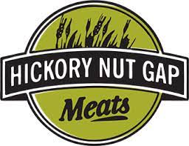

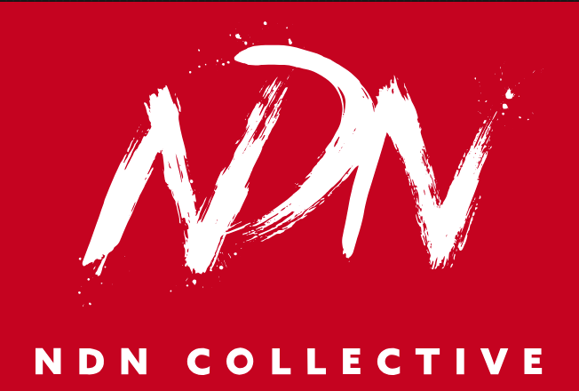







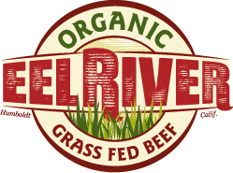
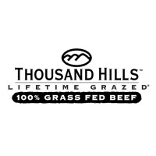





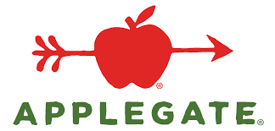

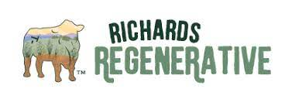

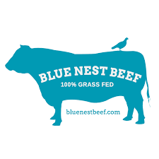




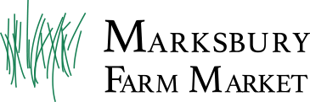

Growing GRASS Grant Partners & Supporters
Cattlemen's Association, Bionutrient Food Association/Utah State University, CarbonSpace, Health Research Institute (HRI) Labs, Dr. John Ikerd, (includes Timberland, Vans, North Face, Smartwool, etc.), Feltman’s of Coney Island, Homeplate Solutions, The Socially Responsible Agriculture Project,
Notes:
Add note to this slide

